Slide 1
6. Management of Healthcare service
Lecturer: Chim Bunthoeurn
Sous Monysathya
Sauchhinsun Harry
Khorn Chamra
Tan Bunan
Tong Banly
Por Chetra
Kimthun Bunly
Kea Revin
Notes:
All

Slide 2
Content
Introduction
Technology
Problem Description & Vision
Database Design
Form Design
Java Application Development
Demo Software
Notes:
Bunan

Slide 3
1. Introduction
Planning
Notes:
Bunan

Slide 4
2. Technology
Programming Language: Java
Integrate Development Environment : NetBeans IDE 8.2
Database: SQL Server
Other: GitHub
Notes:
Bunan

Slide 5
3. Problem Description & Vision
Problem
Decision support systems are all about helping managers making a decision that is heavily supported by the data collected, past experiences, etc. Often, decision support systems are based on more than one database. This allows for integration of more data, and it results in a better decision-making process. Integrating different databases, however, is not an easy task. For example, although very critical, there are cases where the databases at clinics and insurance companies are not integrated. This lack of integration has a twofold effect:
insurance companies find it difficult to design or negotiate health care programs; and
practitioners are unable to take advantage of or participate in designing insurance programs.
Vision
The aim of this project is to design a decision support system that will integrate the data stored in different insurance companies and health care providers.
The objective is to provide supporting information to the participants to make the right decision about insurance programs.
Notes:
Mazor

Slide 6
4. Database Design
Disease
1
Is cured by
M
Doctor
1
Work for
M
1
M
1
1
1
M
1
1
M
has
1
Patient
1
Visit
M
HealthCare Provider
1
M
M
1
1
M
1
M
Premium
1
Insurance Company
M
Cooperate
1
1
M
1
1
1
1
1
1
Transaction
Healthcare Plan
M
Has
M
1
Notes:
Banly

Slide 7
5. Form Design
Login and Register
Data Entry
Healthcare Provider
Search ( Disease )
Doctor
Patient
Notes:
Chetra

Slide 8
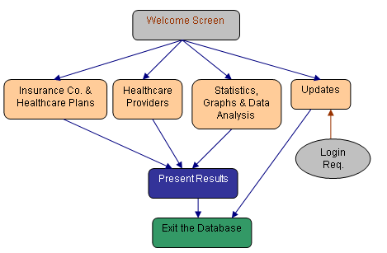
6. Java Application Development
Notes:
Harry

Slide 9
7. Demo Software
Notes:
Sathya, Harry, v.s Ravin, Bunly

Slide 10
Thank you

